Slide 1

X++ Development Tips and Tricks plus D365FO.Tools!
Re-Recording

Slide 2
Synopsis
In this session, we’ll go over some tips, tricks, tools and methods to get more done, to help with complicated processes, and help make Visual Studio your home with Dynamics 365 for Finance and Operations Visual Studio Tools. We’ll focus on utilizing tools that Microsoft has made as well as some community tools that can make your life easier.
PowerPoint available for download at https://github.com/NathanClouseAX/CommunityPresentations/tree/master/2021

Slide 3

Nathan Clouse
Technical Architect enVista Corp.
Microsoft Business Applications MVP (2x)
nclouse@envistacorp.com
www.atomicax.com
www.dynamics.fo
@NathanClouseAX

Slide 4

Peter Ramer
(detail)

Slide 5

Contents
Coding Tips
D365FO.Tools
Quality of Life Hacks
PowerShell
Visual Studio Hidden Gems
Debugging

Slide 6

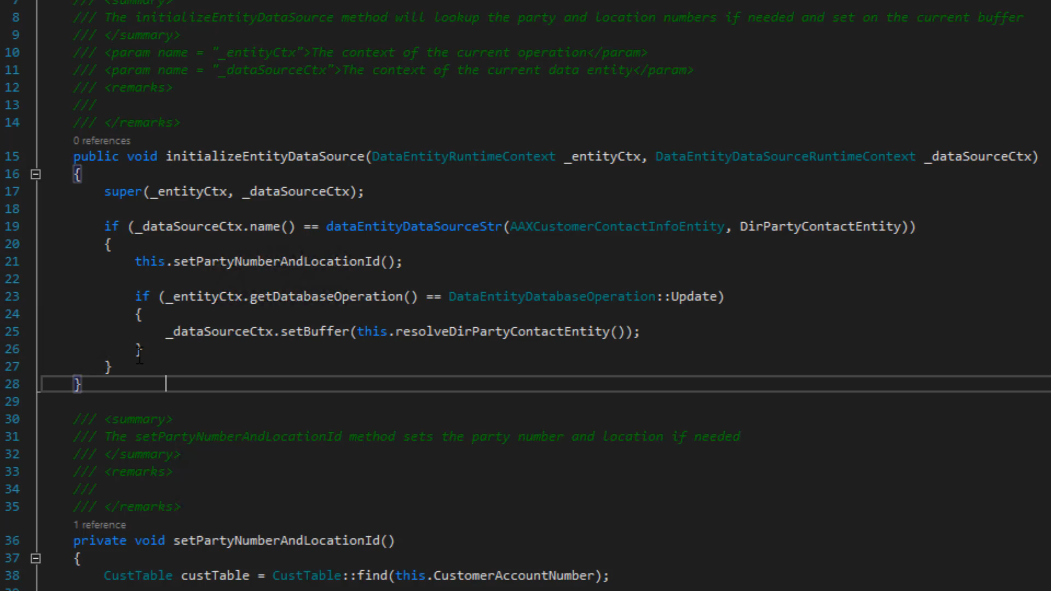
Comment Code
CTRL K, CTRL C

Slide 7
Uncomment Code
CTRL K, CTRL U

Slide 8
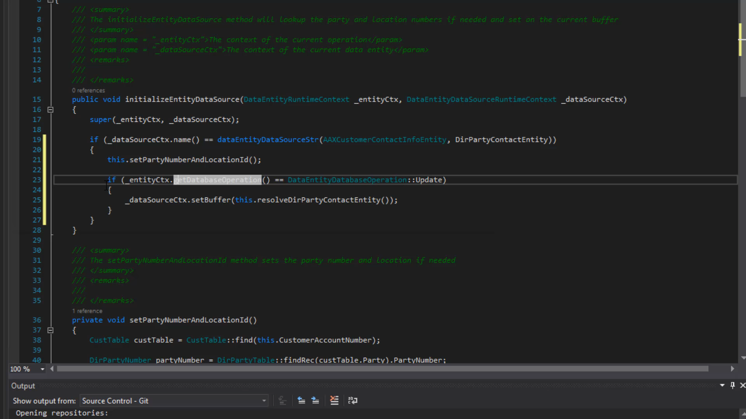
Format Code
CTRL K , D

Slide 9
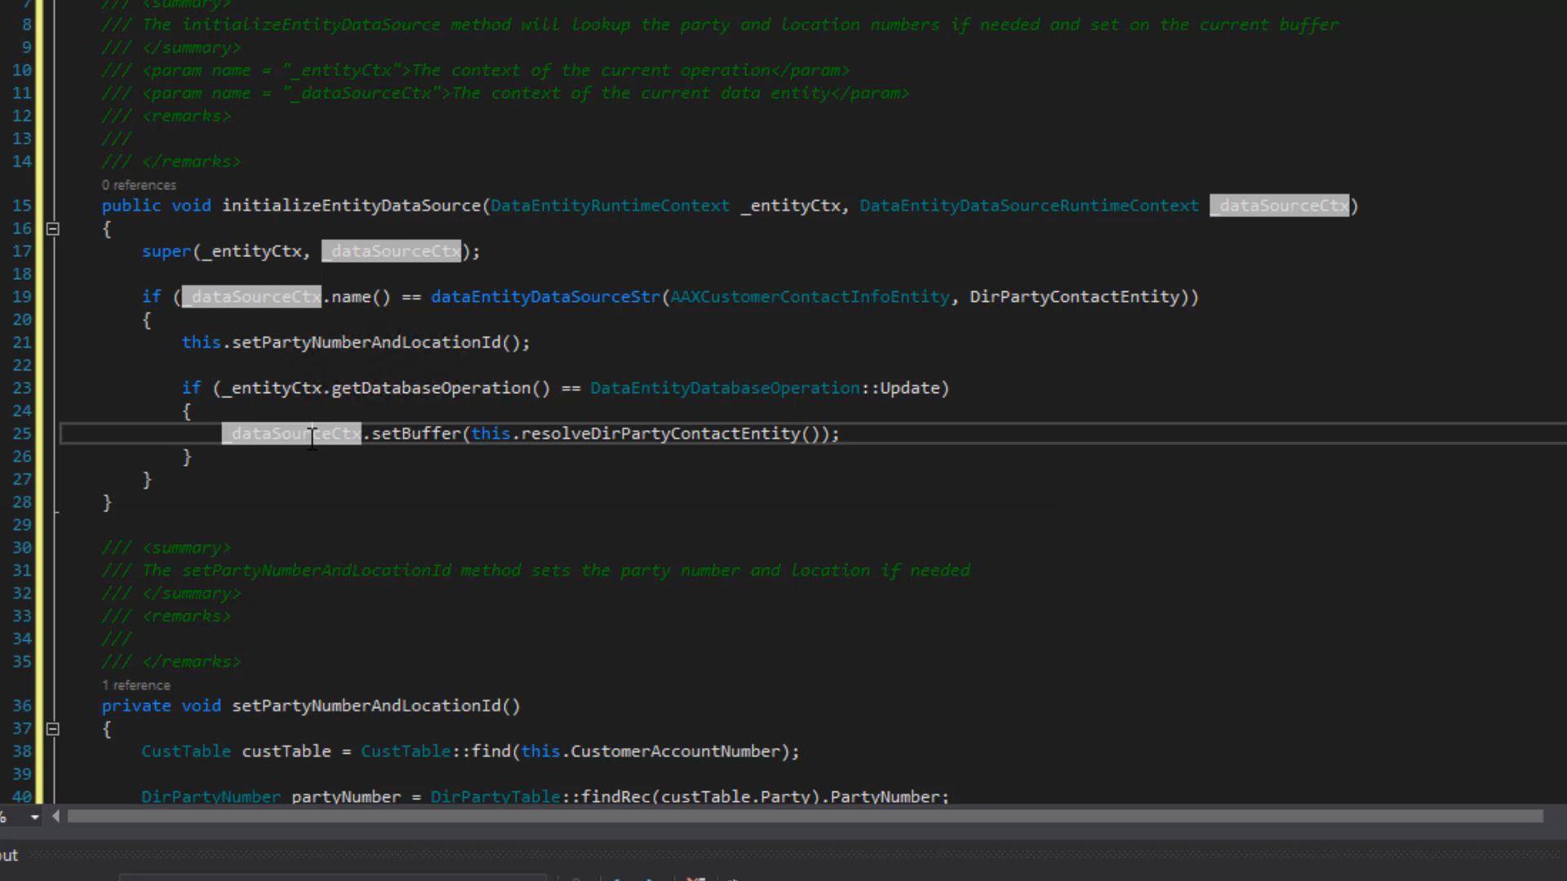
Toggle Breakpoints
F9

Slide 10
Go To (Main Thing)
Hit F9 in design view to go to the main thing for the item selected
F9 on a table extension will take you to the base table
F9 on a field will take you to the EDT
F9 on a field with a relationship will take you to the related table
F9 on a field in a data entity will open the table/entity for that field
F9 on COC Extension Class will take you to the main class

Slide 11
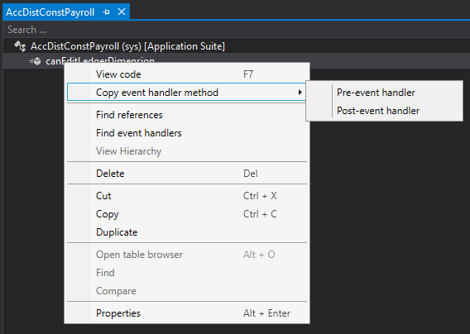
Copy Event Handlers - Methods
In design view, expand methods, right click, copy event handler

Slide 12
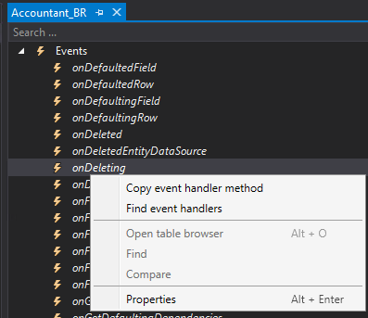
Copy Event Handler - Events
In design view, expand events, right click, copy event handler

Slide 13

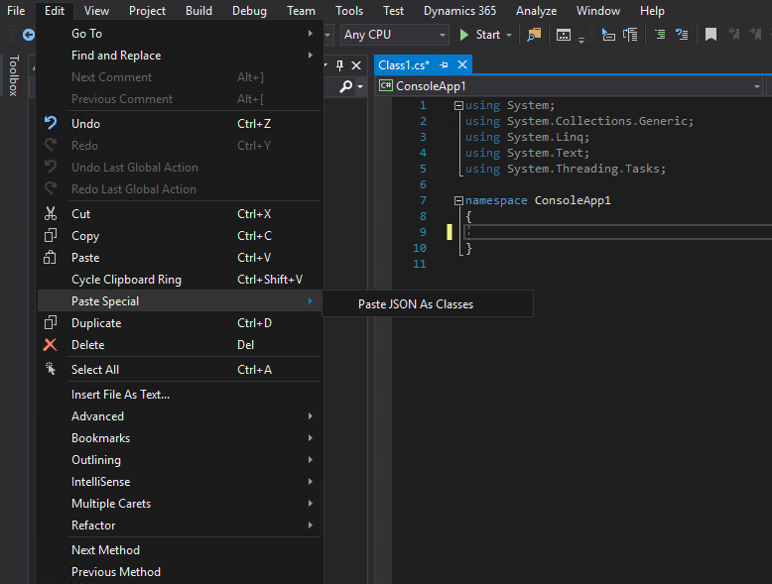
Paste Special
Edit > Paste Special
XML as Class
JSON as Class

Slide 15
Paste Special
{"menu": {
"id": "file",
"value": "File",
"popup": {
"menuitem": [
{"value": "New", "onclick": "CreateNewDoc()"},
{"value": "Open", "onclick": "OpenDoc()"},
{"value": "Close", "onclick": "CloseDoc()"}
]
}
}}
public class Menu
{
public string id { get; set; }
public string value { get; set; }
public Popup popup { get; set; }
}
public class Popup
{
public Menuitem[] menuitem { get; set; }
}
public class Menuitem
{
public string value { get; set; }
public string onclick { get; set; }
}

Slide 16
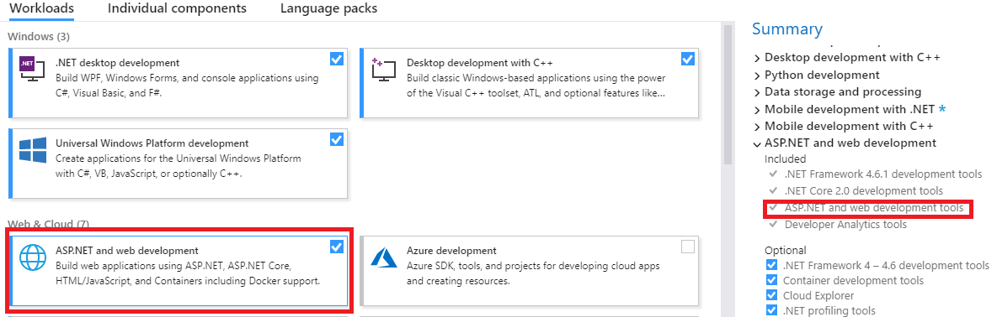
If XML Option Missing…
Add ASP.NET to VS

Slide 17
CrossCompany
static void JobDemoCrossCompany(Args _args)
{
BankAccountTable tabBAT; // saveDataPerCompany == true.
container conCompanies = [ 'cm1', 'cm2', 'dat' ];
str 4 sCompanyPrevious = " "; // Maximum length is 4 characters.
int iCountCompanies = 0;
;
while select
crossCompany
: conCompanies
* from tabBAT
order by dataAreaId
{
if ( sCompanyPrevious != tabBAT.dataAreaId )
{
info( tabBAT.dataAreaId + " = tabBAT.dataAreaId" );
iCountCompanies++;
if ( iCountCompanies >= 2 )
{
break;
}
sCompanyPrevious = tabBAT.dataAreaId;
}
}
return;
}

Slide 18
BankAccountTable tabBAT; // saveDataPerCompany == true.
container conCompanies = [ 'cm1', 'cm2', 'dat' ];
str 4 sCompanyPrevious = " "; // Maximum length is 4 characters.
int iCountCompanies = 0;
;
while select
crossCompany
: conCompanies
* from tabBAT
order by dataAreaId
{
…
}
return;
}

Slide 19
CrossCompany Queries
static void JobDemoAllowCrossCompany(Args _args)
{
BankAccountTable tabBAT; // saveDataPerCompany == true.
Query qry2;
QueryBuildDataSource qbds3;
QueryRun qrun4;
str sCompanyPrevious = " ";
int iCountCompanies = 0;
int iTableNumBAT;
;
qry2 = new Query();
qry2.allowCrossCompany( true );
qry2.addCompanyRange( 'dat' );
qry2.addCompanyRange( 'twf' );
iTableNumBAT = tableNum( BankAccountTable );
qbds3 = qry2 .addDataSource( iTableNumBAT );
//qbds3.company( 'dat' );
qrun4 = new QueryRun( qry2 );
while ( qrun4.next() )
{
if ( qrun4.changed( iTableNumBAT ) )
{
tabBAT = qrun4.get( iTableNumBAT );
if ( sCompanyPrevious != tabBAT.dataAreaId )
{
print( tabBAT.dataAreaId + " = tabBAT.dataAreaId" );
iCountCompanies++;
if ( iCountCompanies >= 2 )
{
break;
}
sCompanyPrevious = tabBAT.dataAreaId;
}
}
}
pause;
return;
}

Slide 20
BankAccountTable tabBAT; // saveDataPerCompany == true.
Query qry2;
QueryBuildDataSource qbds3;
QueryRun qrun4;
str sCompanyPrevious = " ";
int iCountCompanies = 0;
int iTableNumBAT;
;
qry2 = new Query();
qry2.allowCrossCompany( true );
qry2.addCompanyRange( 'dat' );
qry2.addCompanyRange( 'twf' );

Slide 21
RunAsPermission
public static container download(container _parms)
{
RunAsPermission perm;
perm = new RunAsPermission("Admin");
perm.assert();
Container returncontainer = runAs("Admin", classnum(AcxSharepointIntegeration), "get", _parms);
CodeAccessPermission::revertAssert();
return returncontainer;
}
Notes:
https://allaboutdynamic.com/2020/07/07/runas-function-method-in-dynamics-365-finance-operations/

Slide 22
StrKeep
str Mobile = "7123456789";
if (strLen(strRem(Mobile, ",")) != strLen(strKeep(strRem(Mobile, ","), "1234567890")))
{ throw error("Invalid Mobile Number"); }
else
{ info("Valid Mobile Number"); }
Notes:
https://allaboutdynamic.com/

Slide 23
StrRFix and StrLFix
static void testZeroPadding(Args _args)
{
int i = 1;
str padded;
str finalResult;
;
// Create a string, with a length of 5, ending with the value of i and padded with zeros
padded = strRFix(int2str(i), 5, "0");
finalResult = strFmt("ABC-%1", padded);
// 00001
}

Slide 24
Use C#
X++ is good but what it can’t do, C# can do
Call an external web service
Handle JSON/XML tedium
FTP

Slide 25
class AAX_AzureQueueTest { const str connectionString = "Endpoint=sb://[urlName]servicebus.windows.net/;SharedAccessKeyName=[SharedAccessName];SharedAccessKey=[SharedAccessKey]=;EntityPath=[QueueName]"; public static void main(Args args) { AAX_AzureQueueLibrary.ReceiveAzureQueue ReceiveAzureQueue = new AAX_AzureQueueLibrary.ReceiveAzureQueue(); AAX_AzureQueueLibrary.SendAzureQueue SendAzureQueue = new AAX_AzureQueueLibrary.SendAzureQueue();
//x++ get a guid, not C# str s = "Test Message " + WinAPIServer::createGUID();
SendAzureQueue.connect(connectionString); SendAzureQueue.sendMessage(s); SendAzureQueue.close();
info(strFmt("sent: %1", s)); s = "";
ReceiveAzureQueue.connect(connectionString);
s = ReceiveAzureQueue.readMessage();
ReceiveAzureQueue.completeMessage();
ReceiveAzureQueue.close();
info(strFmt("Received: %1", s));
}
}

Slide 26
Other Stuff
Can’t locate an error that is being thrown? Add a breakpoint in info.Add() (on switch (logLevel))
Use funcName() to help with figuring problems out
QueryBuildDataSource.toString() to see the SQL for a query
Data Entities can be temperamental; DB Sync, delete entity, rebuild list, test again

Slide 27
D365FO.Tools
PowerShell module to handle the different management tasks during a Dynamics 365 Finance & Operations
Install-Module -Name d365fo.tools
Update-Module -name d365fo.tools

Slide 28
Stop An Environment
Stop-D365Environment -All
Stop-D365Environment -Aos -Batch
Stop-D365Environment -FinancialReporter -DMF
Stop-D365Environment -All -Kill

Slide 29
Start An Environment
Start-D365Environment -ShowOriginalProgress
Start-D365Environment -All
Start-D365Environment -Aos -Batch
Start-D365Environment -FinancialReporter -DMF

Slide 30
Restart
Restart-D365Environment -All -ShowOriginalProgress

Slide 31
(Re)Set D365FO Admin
Set-D365Admin "claire@contoso.com"

Slide 32
Export Database from Sandbox
Invoke-D365LcsDatabaseExport -ProjectId 123456789 -SourceEnvironmentId "958ae597-f089-4811-abbd-c1190917eaae" -BackupName "BackupViaApi" -BearerToken "JldjfafLJdfjlfsalfd..." -LcsApiUri "https://lcsapi.lcs.dynamics.com"
Notes:
https://blog.simonw.se/getting-an-access-token-for-azuread-using-powershell-and-device-login-flow/

Slide 33
Refresh Database (Prod To Sandbox)
Invoke-D365LcsDatabaseRefresh -ProjectId 123456789 -SourceEnvironmentId "958ae597-f089-4811-abbd-c1190917eaae" -TargetEnvironmentId "13cc7700-c13b-4ea3-81cd-2d26fa72ec5e" -BearerToken "JldjfafLJdfjlfsalfd..." -LcsApiUri "https://lcsapi.lcs.dynamics.com"
Notes:
https://blog.simonw.se/getting-an-access-token-for-azuread-using-powershell-and-device-login-flow/

Slide 34
Sync Database for Module(s)
Invoke-D365DbSyncModule -Module "MyModel1"
Invoke-D365DbSyncModule -Module "MyModel1","MyModel2"
Get-D365Module -Name "MyModel*" | Invoke-D365DbSyncModule

Slide 35
Partial DB Sync
Invoke-D365DBSyncPartial -SyncList "CustCustomerEntity","SalesTable"
Invoke-D365DBSyncPartial -SyncList "CustCustomerEntity","SalesTable" -Verbose

Slide 36
DB Sync
Invoke-D365DBSync
Invoke-D365DBSync -Verbose

Slide 37
Install Supporting Software
Install-D365SupportingSoftware -Name vscode
Install-D365SupportingSoftware -Name "vscode","fiddler"
Install-D365SupportingSoftware -Name googlechrome

Slide 38
Getting Environment URL
Get-D365Url

Slide 39
Searching for an AOT Object
Get-D365AOTObject -Name *flush* -ObjectType AxClass -Path "C:\AOSService\PackagesLocalDirectory\ApplicationFoundation"
Get-D365AOTObject -Name *flush* -ObjectType AxClass -IncludePath -Path "C:\AOSService\PackagesLocalDirectory\ApplicationFoundation"
Get-D365InstalledPackage -Name Application* | Get-D365AOTObject -Name *flush* -ObjectType AxClass
Get-D365AOTObject -Path "C:\AOSService\PackagesLocalDirectory\*" -Name *flush* -ObjectType AxClass -SearchInPackages

Slide 40
Maintenance Mode
Enable-D365MaintenanceMode -ShowOriginalProgress
Disable-D365MaintenanceMode -ShowOriginalProgress

Slide 41
Import Database into Dev (T1)
Invoke-D365InstallSqlPackage
Import-D365Bacpac -ImportModeTier1 -BacpacFile "C:\temp\uat.bacpac" -NewDatabaseName "ImportedDatabase_YYYYMMDD"

Slide 42
Export Database from Dev (T1)
New-D365Bacpac -ExportModeTier1 -BackupDirectory c:\Temp\backup\ -NewDatabaseName Testing1 -BacpacFile "C:\Temp\Bacpac\Testing1.bacpac"

Slide 43
Quality Of Life

Slide 44
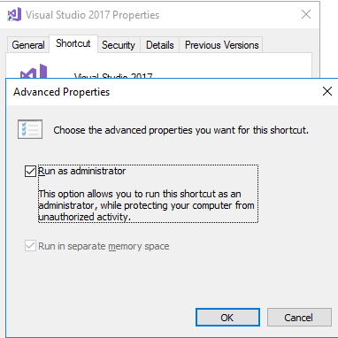
Run VS as Admin
Start
Search for Visual Studio 2017
Right click > Open file location
Find icon, right click > Properties > Advanced
Check “Run As Administrator”

Slide 45
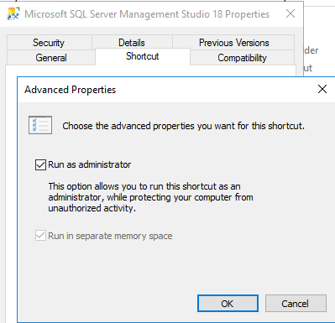
Run SSMS as Admin
Nearly the same as for VS 2017

Slide 46
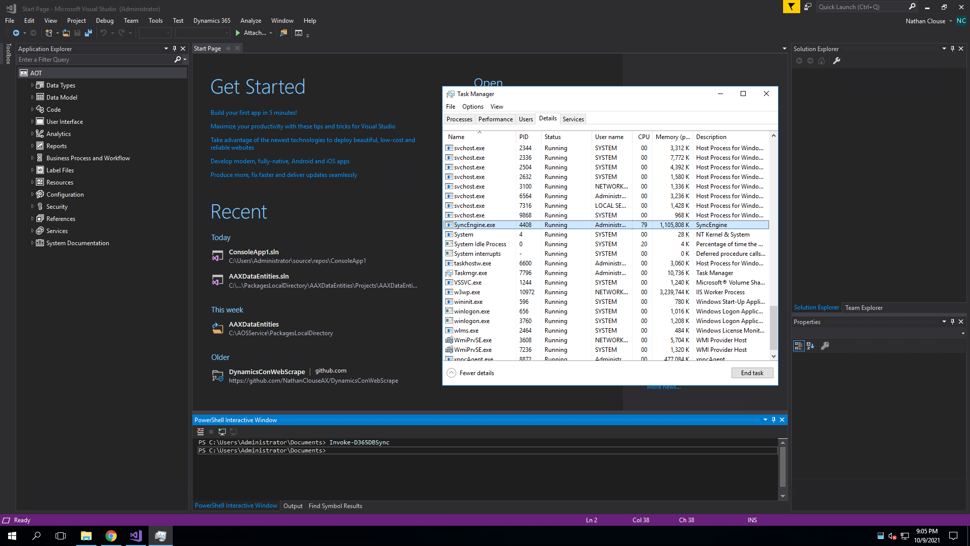
Run D365FO.Tools in VS
Run PowerShell from VS
Like D365FO.Tools
Notes:
http://www.atomicax.com/article/d365fotools-and-vs2017-manhattan-project

Slide 47
Notes:
http://www.atomicax.com/article/d365fotools-and-vs2017-manhattan-project

Slide 48
Notes:
http://www.atomicax.com/article/d365fotools-and-vs2017-manhattan-project

Slide 49

Plus Aliases
Use notepad $profile

Slide 52
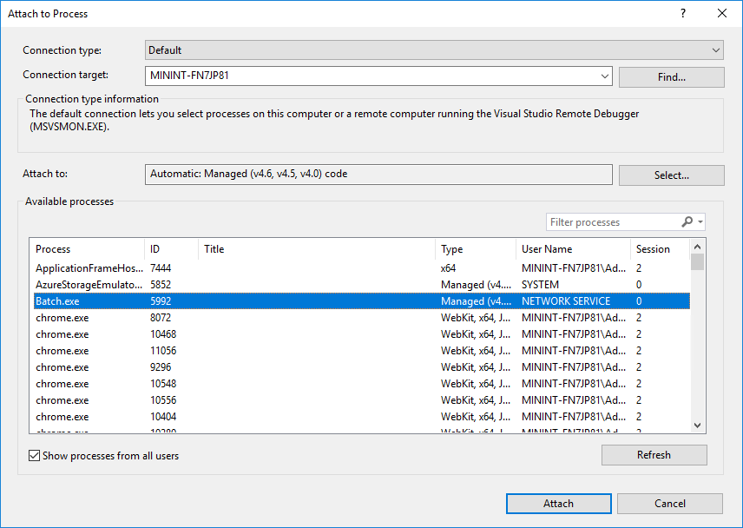
Debugging Batch Jobs
Attached to process
Show all processes from all users
Look for Batch.exe

Slide 53
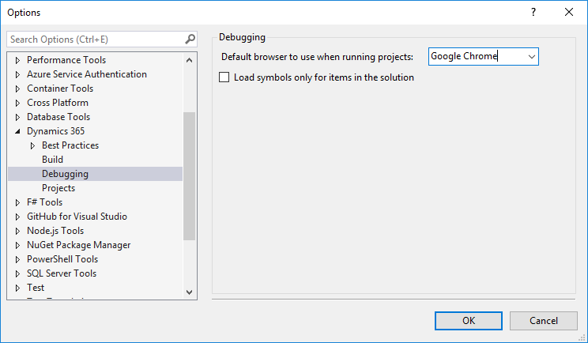
Loading Symbols
Tools > Options

Slide 55
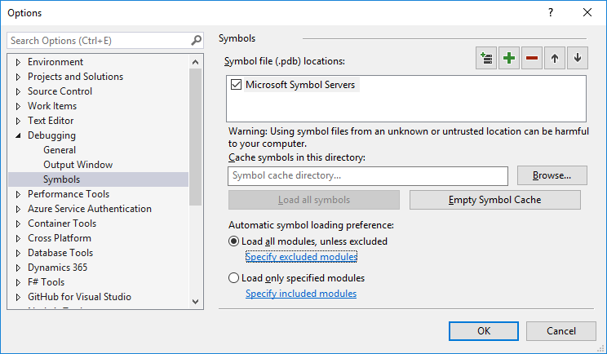

Slide 56
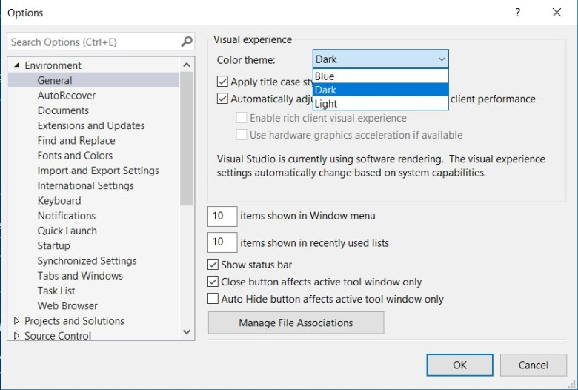
Dark Mode Plus Custom Colors
Notes:
https://jatomas.com/en/2020/05/02/dark-mode-visual-studio-x-code-editor/

Slide 57
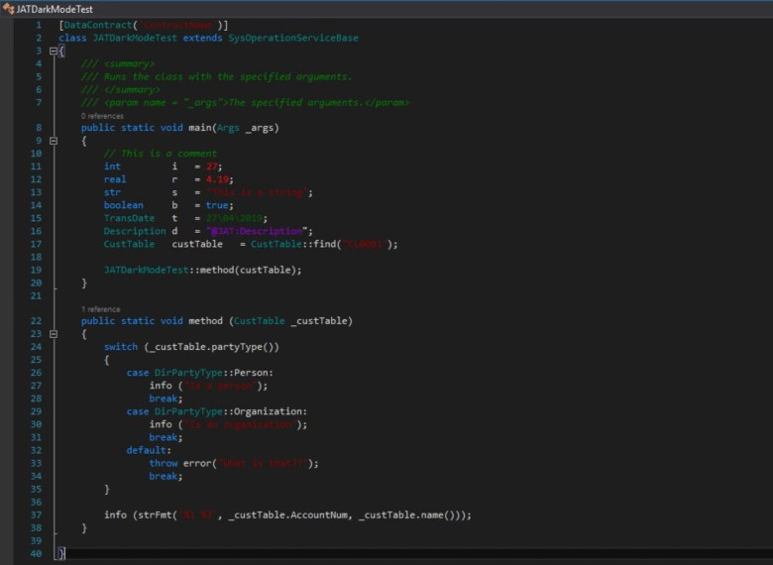
Dark Mode Plus Custom Colors
Notes:
https://jatomas.com/en/2020/05/02/dark-mode-visual-studio-x-code-editor/

Slide 58
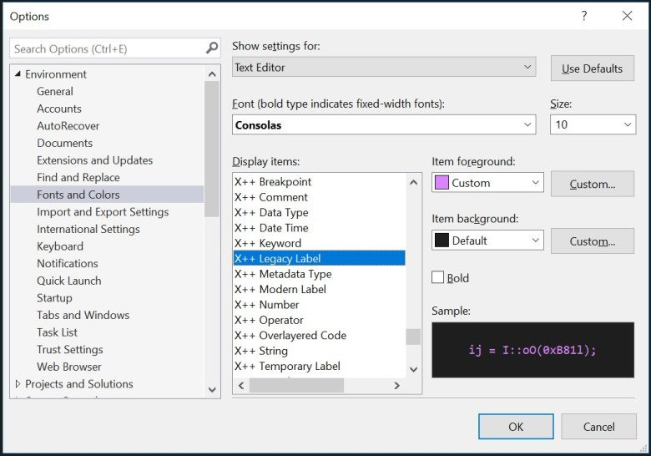
Dark Mode Plus Custom Colors
Notes:
https://jatomas.com/en/2020/05/02/dark-mode-visual-studio-x-code-editor/

Slide 59
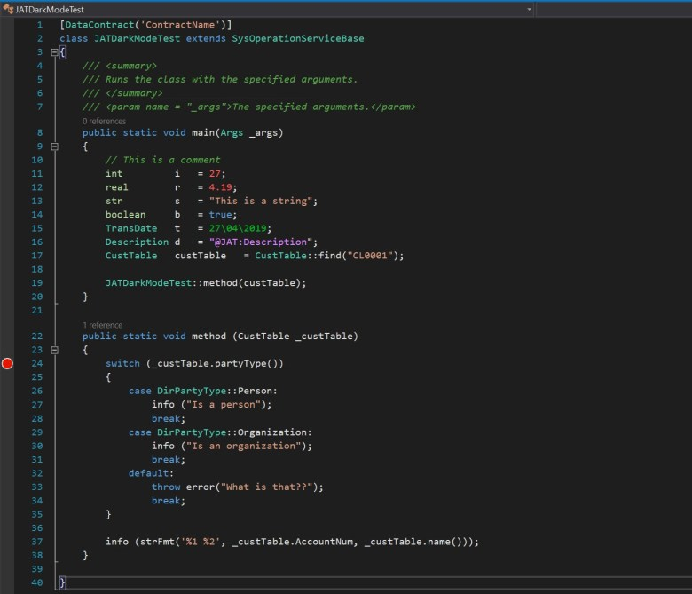
Dark Mode Plus Custom Colors
Notes:
https://jatomas.com/en/2020/05/02/dark-mode-visual-studio-x-code-editor/

Slide 60
Notes:
https://jatomas.com/en/2020/05/02/dark-mode-visual-studio-x-code-editor/

Slide 61
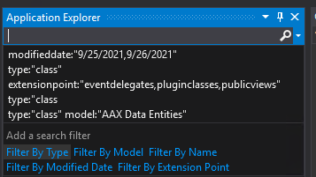
Metadata Search
Search on any option, value, metadata, whatever, on an element
type:"form" ccount
type:"class" extensionpoint:"eventhandlers,eventdelegates"

Slide 62
Metadata Search
type:"dataentityview" property:"PublicCollectionName=CustomerStatisticsGroups"
type:"dataentityview" property:"PublicEntityName=CustomerStatisticsGroup"

Slide 63
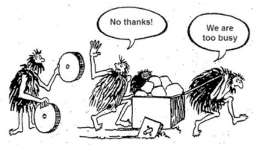
TRUDUtilsD365
Open Source
https://github.com/TrudAX/TRUDUtilsD365
Prototyping Tools that help with productivity
Configurable
Similar idea from AX 2009/2012 with configurable MorphX tools

Slide 64
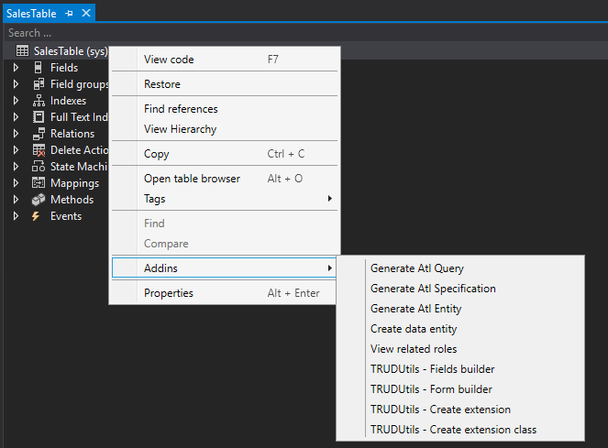

Slide 65
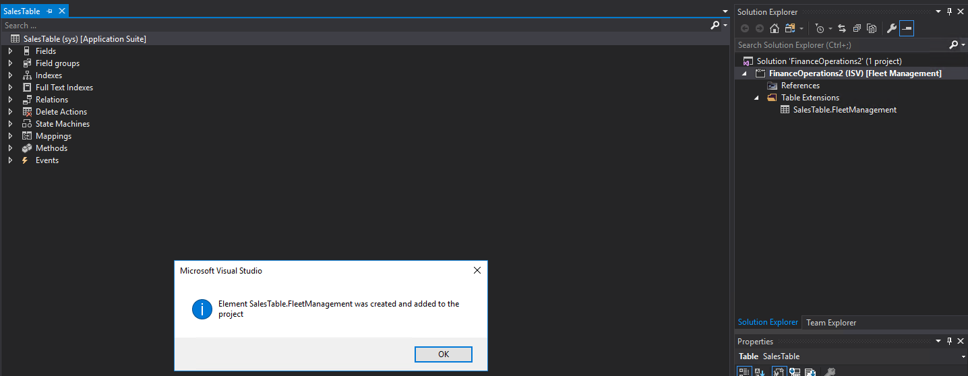
Notes:
Create table extension

Slide 66
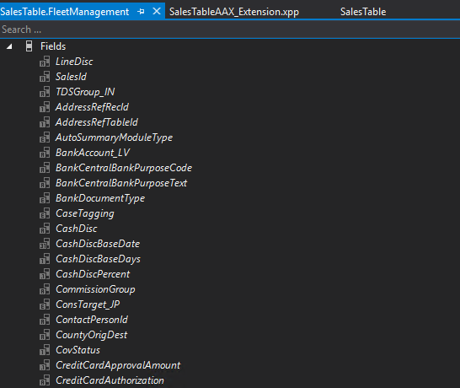
Notes:
Create table extension

Slide 67
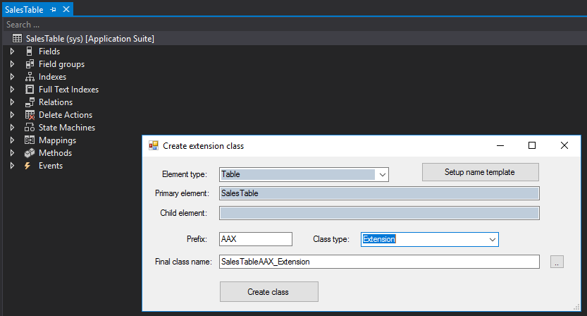
Notes:
Create table class extension

Slide 68
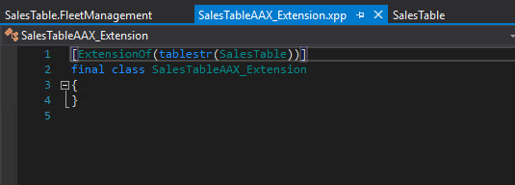
Notes:
Create table class extension

Slide 69
Resources
http://www.atomicax.com/article/d365fotools-and-vs2017-manhattan-project
https://docs.microsoft.com/en-us/dynamics365/fin-ops-core/dev-itpro/dev-ref/xpp-business-run-time-functions
https://docs.microsoft.com/en-us/dynamics365/fin-ops-core/dev-itpro/dev-ref/xpp-string-run-time-functions
https://jatomas.com/en/2020/05/02/dark-mode-visual-studio-x-code-editor/

Slide 70
Thanks!
Nathan Clouse
nclouse@envistacorp.com
www.atomicax.com
www.dynamics.fo
@NathanClouseAX
Peter Ramer
(Details)

